Slide 1
Ch.2 Parameter Extraction in
Time-Domain Spectrometers
Lee Jong Geon

Slide 2
Contents
Material Properites and Wave Propagation
Extracting Optical Parameters fromTerahertz Time-Domain Spectromerters Data
Preprocessing and Postprocessing of Data
Sample Requirements

Slide 3
Material Properties and
Wave Propagation

Slide 4



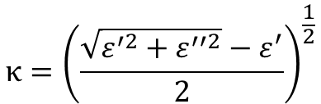
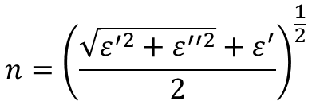

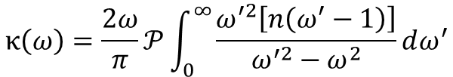
1.1 Complex Refeactive Index and Complex Permitivity
Complex Refractive Index
$$n={\left(\frac{\sqrt{ε^{′2}+ε^{′′2}}+ε^{′}}{2}\right)}^{\frac{1}{2}}$$
$$\overline{n}=n^{′} −jκ$$
$$\overline{ε}= {\overline{n}}^{2}$$
Complex Permittivity Index
$$κ={\left(\frac{\sqrt{ε^{′2}+ε^{′′2}}−ε^{′}}{2}\right)}^{\frac{1}{2}}$$
$$\overline{ε}=ε^{′} −jε^{′′}$$
Kramers-Kronig relations
$$n\left(ω\right)=1+\frac{2ω}{π}𝒫\int_{0}^{∞}{\frac{κ\left(ω^{′}\right)}{ω^{′2}−ω^{2}}dω^{′}}$$
$$κ\left(ω\right)=\frac{2ω}{π}𝒫\int_{0}^{∞}{\frac{ω^{′2}\left[n\left(ω^{′}−1\right)\right]}{ω^{′2}−ω^{2}}dω^{′}}$$

Slide 5
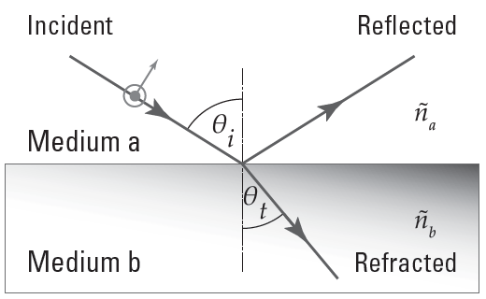






1.2 Plane Wave Propagation Across an Interface – Fresnel Equations
$$t_{TE}=\frac{2{\overline{n}}_{a}\cos{θ_{i}}}{{\overline{n}}_{a}\cos{θ_{i}}+{\overline{n}}_{b}\cos{θ_{t}}}$$
$$t_{TM}=\frac{2{\overline{n}}_{a}\cos{θ_{i}}}{{\overline{n}}_{a}\cos{θ_{t}}+{\overline{n}}_{b}\cos{θ_{i}}}$$
$$r_{TE}=\frac{{\overline{n}}_{a}\cos{θ_{i}} −{\overline{n}}_{b}\cos{θ_{t}}}{{\overline{n}}_{a}\cos{θ_{i}}+{\overline{n}}_{b}\cos{θ_{t}}}$$
$$r_{TM}=\frac{{\overline{n}}_{a}\cos{θ_{t}} −{\overline{n}}_{b}\cos{θ_{i}}}{{\overline{n}}_{a}\cos{θ_{t}}+{\overline{n}}_{b}\cos{θ_{i}}}$$
$$r_{b→a}=−r_{a→b}$$
$$t_{a→b}t_{b→a}=1−r_{a→b}^{2}$$

Slide 6
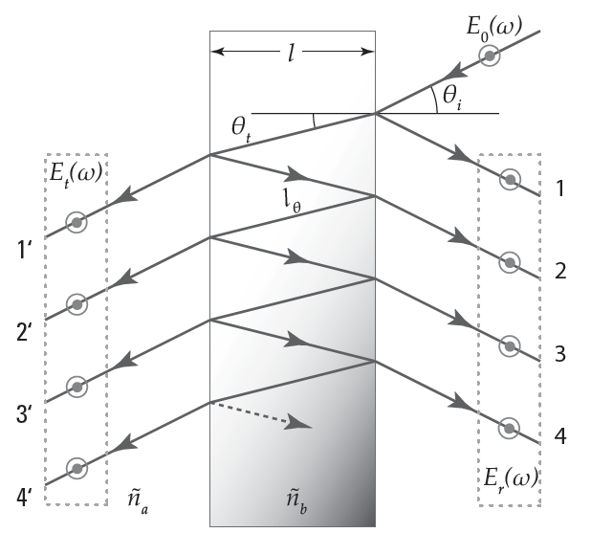
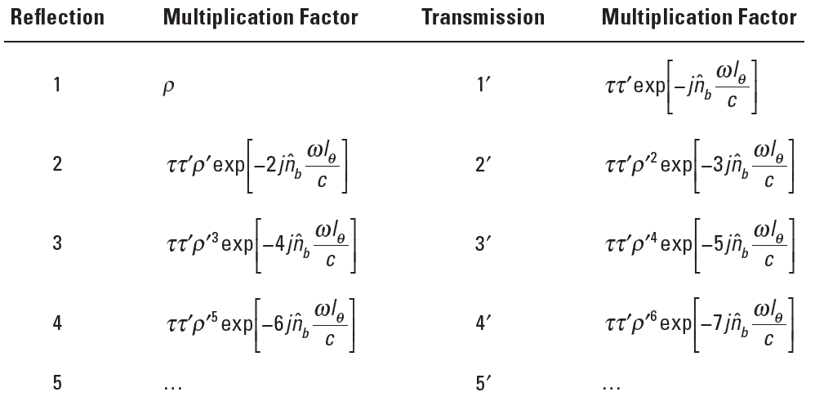
1.3 Plane Wave Propagation Through a Dielectric Slab

Slide 7
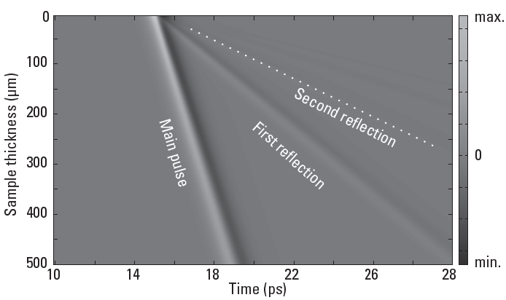
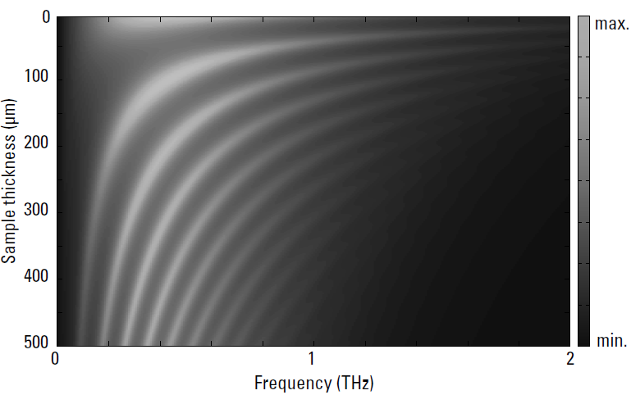


1.4 Fabry-Pérot Effect
$$∆t=\frac{2n_{g}l}{c}$$
$$∆f=\frac{c}{2n_{g}l}$$

Slide 8
Extracting Optical Parameters from
Terahertz TDS Data

Slide 9

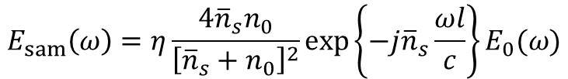
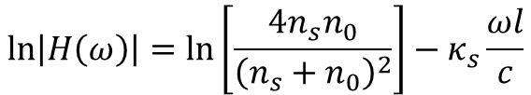

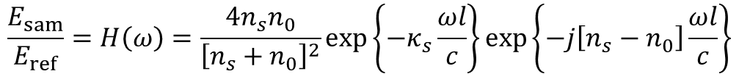
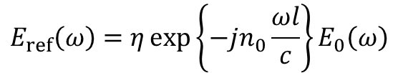
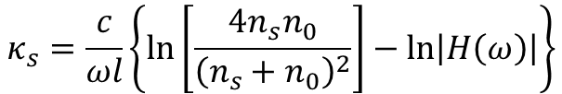
2.1 Transmission-Mode Terahertz TDS: Approximation
Dielectric slab at normal incidence
$$E_{sam}\left(ω\right)=η\frac{4{\overline{n}}_{s}n_{0}}{{\left[{\overline{n}}_{s}+n_{0}\right]}^{2}}\exp\left\{−j{\overline{n}}_{s}\frac{ωl}{c}\right\}E_{0}(ω)$$
$$E_{ref}\left(ω\right)=η\exp\left\{−jn_{0}\frac{ωl}{c}\right\}E_{0}\left(ω\right)$$
$$\frac{E_{sam}}{E_{ref}}=H\left(ω\right)=\frac{4n_{s}n_{0}}{{\left[n_{s}+n_{0}\right]}^{2}}\exp\left\{−κ_{s}\frac{ωl}{c}\right\}\exp\left\{−j\left[n_{s}−n_{0}\right]\frac{ωl}{c}\right\}$$
$$∠H\left(ω\right)=−\left[n_{s}−n_{0}\right]\frac{ωl}{c}$$
$$\ln\left|H\left(ω\right)\right|=\ln\left[\frac{4n_{s}n_{0}}{{\left(n_{s}+n_{0}\right)}^{2}}\right]−κ_{s}\frac{ωl}{c}$$
$$n_{s}=n_{0}−\frac{c}{ωl}∠H\left(ω\right)$$
$$κ_{s}=\frac{c}{ωl}\left\{\ln\left[\frac{4n_{s}n_{0}}{{\left(n_{s}+n_{0}\right)}^{2}}\right]−\ln\left|H\left(ω\right)\right|\right\}$$

Slide 10
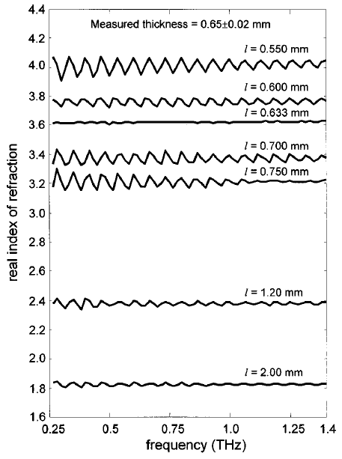
2.2 Transmission-Mode Terahertz TDS: Exact Solution
It is based on minimizing error in the magnitude and phase components of the modeled transfer function with respect th the measured transfer function
Gradient-Descent Algorithm
Step 1: Estimate a range of possible thickness
Step 2: Initialize the complex refractive index
Step 3: Determine the modeled transfer function
Step 4: Estimate the error
Step 5: Update the complex refractive index
Step 6: Determine the total variation
Dorney, T., R. Baraniuk, and D. Mittleman, “Material Parameter Estimation with Terahertz Time-Domain Spectroscopy,” Journal of the Optical Society of America A: Optics, Image Science, and Vision, Vol. 18, No. 7, 2001.

Slide 11
2.3 Reflection-Mode Terahertz TDS: Single Reflection
Single reflection → Two scan (reference, sample)
Double reflection → One scan (combined)
Gradient-Descent Algorithm
Dorney, T., R. Baraniuk, and D. Mittleman, “Material Parameter Estimation with Terahertz Time-Domain Spectroscopy,” Journal of the Optical Society of America A: Optics, Image Science, and Vision, Vol. 18, No. 7, 2001.

Slide 12
References
Dorney, T., R. Baraniuk, and D. Mittleman, “Material Parameter Estimation with Terahertz Time-Domain Spectroscopy,” Journal of the Optical Society of America A: Optics, Image Science, and Vision, Vol. 18, No. 7, 2001, pp. 1562-1571.

